Slide 1
HDFC Capstone Project
NotifySafe – Multi-Channel Notification Delivery Simulator
Subtitle: Reliable, Secure & Timely Delivery of Critical User Alerts
Presented By: Sarangaraj Kashyap CU.26, MCA, Cotton University

Slide 2

Contents
Problem Statement
Challenges and Gaps
Proposed Solution
Project Overview
Key Features
Technical Stack
System Context Diagram
System Architecture
Event Flow Diagram
UI Screenshots
Impact
Limitations and Future Enhancements
Conclusion

Slide 3
Problem Statement
Context
In today’s digital ecosystem, transactional notifications — such as OTPs, payment alerts, and account activity messages — are mission-critical for user trust and security. Yet, users frequently experience missed or delayed alerts, duplicate messages, or spoofed (phishing-like) notifications. These gaps not only hurt customer experience but also weaken the bank’s reputation for reliability and safety.

Slide 4
Challenges and Gaps
No Unified Event Logic e
Inconsistent Delivery
Low user trust
Spoofing & Phishing
Retry Logic Missing

Slide 5
Proposed Solution
NotifySafe - Multi-Channel Notification Delivery Simulator
A production-ready React + Appwrite web application that demonstrates how user-triggered events flow through a multi-channel notification delivery system in real-time.
This project simulates event generation, template rendering, delivery attempts across SMS, Email, and In-App channels, with fallback handling and comprehensive analytics.

Slide 6
Project Overview
NotifySafe is an event-driven notification simulator that shows the complete lifecycle of notifications:
Event Triggering: Users manually trigger predefined event types from the dashboard.
Template Rendering: Events are matched with notification templates and rendered with dynamic variables.
Multi-Channel Delivery: Notifications attempt delivery across 3 channels with configurable success rates:
Email: 85% success rate
SMS: 80% success rate
In-App: 100% success rate
Fallback Logic: Failed deliveries fall back to user inbox storage.
Real-Time Logging: All delivery attempts and outcomes are tracked in Appwrite Database.
Analytics Dashboard: Visualize delivery metrics, success rates, and channel breakdown.

Slide 7
Key Features

Slide 8
1. Event Management
Examples of some pre-defined Event Types:
LOGIN_SUCCESS - User authentication events
ACCOUNT_DEBITED - Financial transaction alerts
PASSWORD_CHANGED - Security notifications
OTP_SENT - Multi-factor authentication codes
Manual Event Triggering: Skip user input forms; directly simulate events with one click.
Event Type Selection: Choose which event to trigger from the UI.

Slide 9
2. Multi-Channel Notification Delivery
Email Channel: Simulated SMTP delivery (85% success).
SMS Channel: Simulated SMS provider delivery (60% success).
In-App Channel: Browser-based notifications (100% reliable).
Automatic Fallback: Undelivered notifications stored in user inbox for later retrieval.

Slide 10
3. Template System
Versioned Templates: Track template changes over time.
Handlebars Syntax: Support for dynamic variables ({{username}}, {{amount}}, etc.)
Template Editor: Create and edit notification templates with version history.
Built-in Templates: Default templates for many events.

Slide 11
4. Activity & Monitoring
Activity Logs: Complete audit trail of all notification events and delivery attempts.
User Inbox: Per-user message storage for failed or undelivered notifications.
Real-time Synchronization: Appwrite Database integration for live data updates.
Timestamp Tracking: Precise logging of all events with server timestamps.

Slide 12
5. Authentication & Authorization
Appwrite Authentication: Email/password signup and login with session management
Role-Based Access Control:
user role: Access inbox, activity, dashboard
privileged role: Additional access to template editor
Protected Routes: Client-side authorization guards
Session Management: Persistent authentication with Appwrite

Slide 13
Tech Stack
Layer | Technology | Purpose
Frontend | React 18 + Vite 7.2 | Modern, fast UI with HMR
Styling | Tailwind CSS (v4 @tailwindcss/vite) | Utility-first CSS
Routing | React Router 6 | Client-side navigation & protected routes
Backend | Appwrite (Auth, Database, Functions) | Open-source backend-as-a-service
Database | Appwrite Database | Real-time NoSQL document storage
Cloud Functions | Appwrite Functions (Node.js) | Server-side notification delivery engine
Notifications | React Hot Toast | In-app toast notifications
Testing | Vitest + React Testing Library | Unit tests with jsdom environment

Slide 14
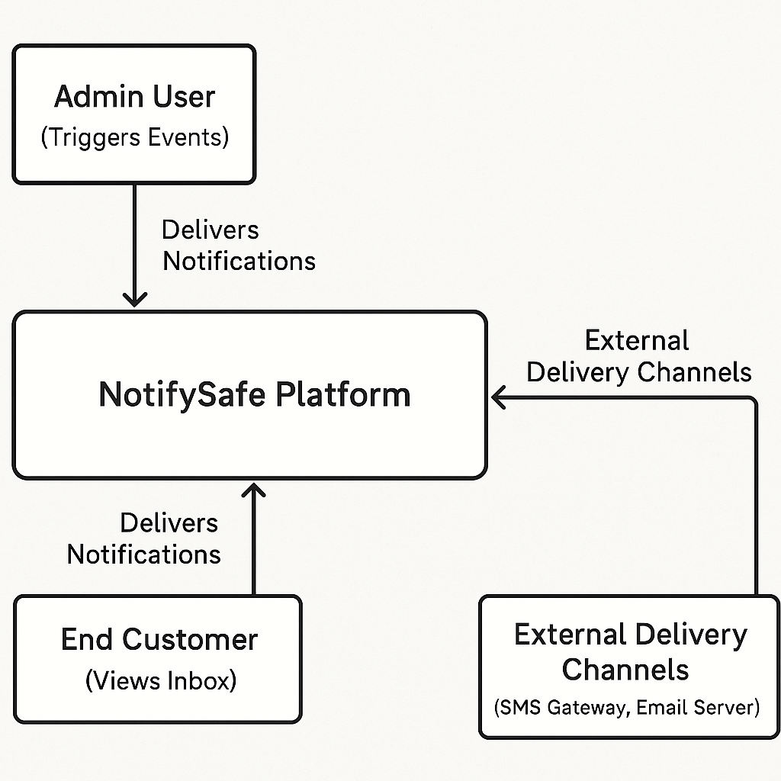
System Context Diagram

Slide 15
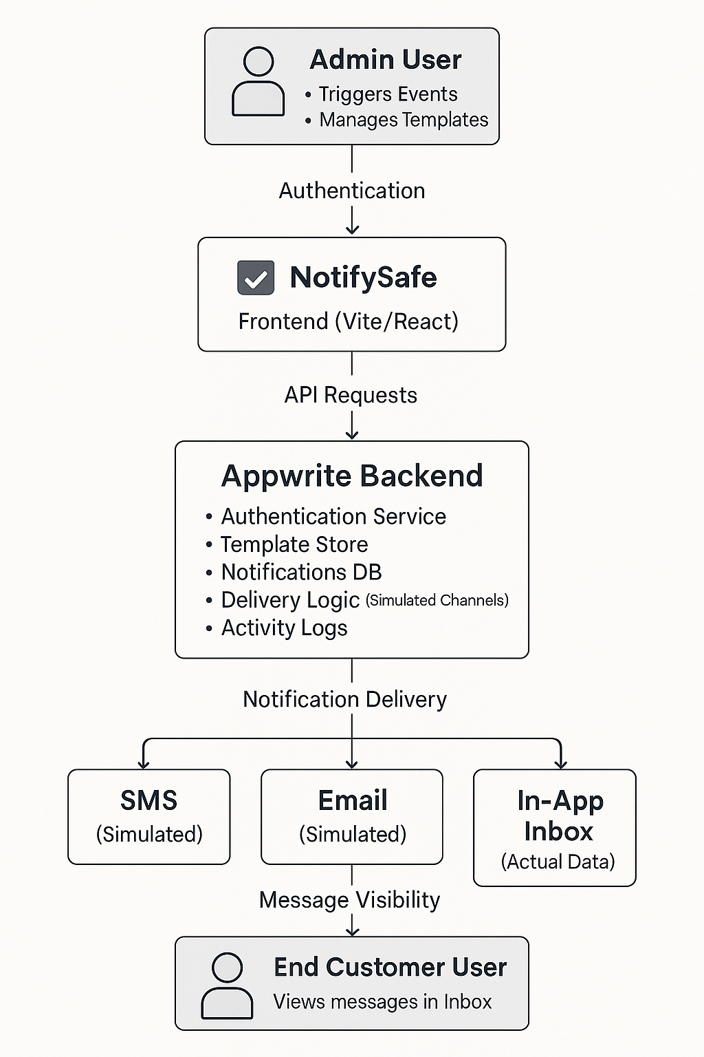
System Architecture Diagram

Slide 16
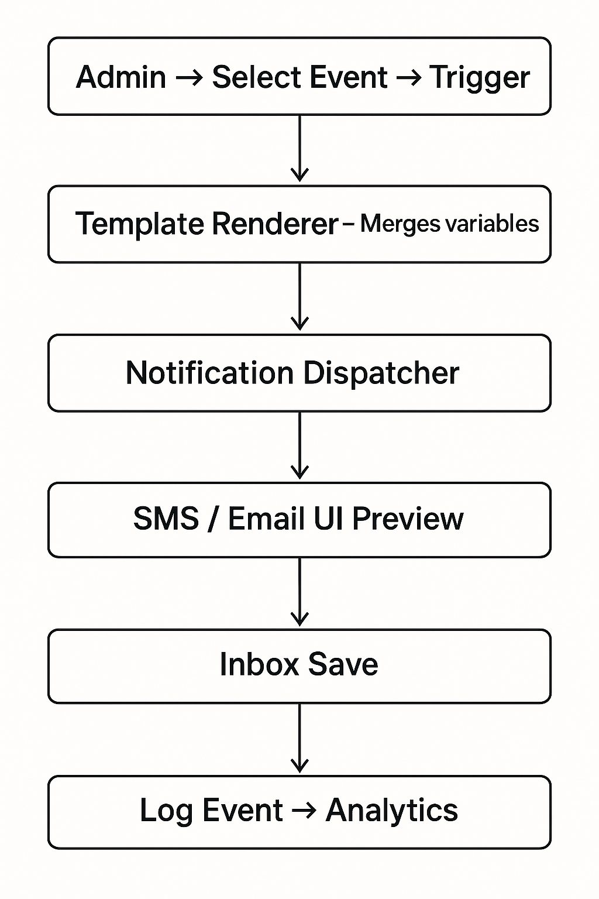
Event Flow Diagram
1. Admin selects an event to trigger.
2. Frontend sends event info to backend.
3. Template loads and renders dynamic variables.
4. Delivery attempts made across SMS, Email, In-App.
5. Results stored in activitylogs.
6. If all attempts fail, message saved to inbox.
7. Analytics dashboard updates metrics.

Slide 17
UI Screenshots

Slide 18
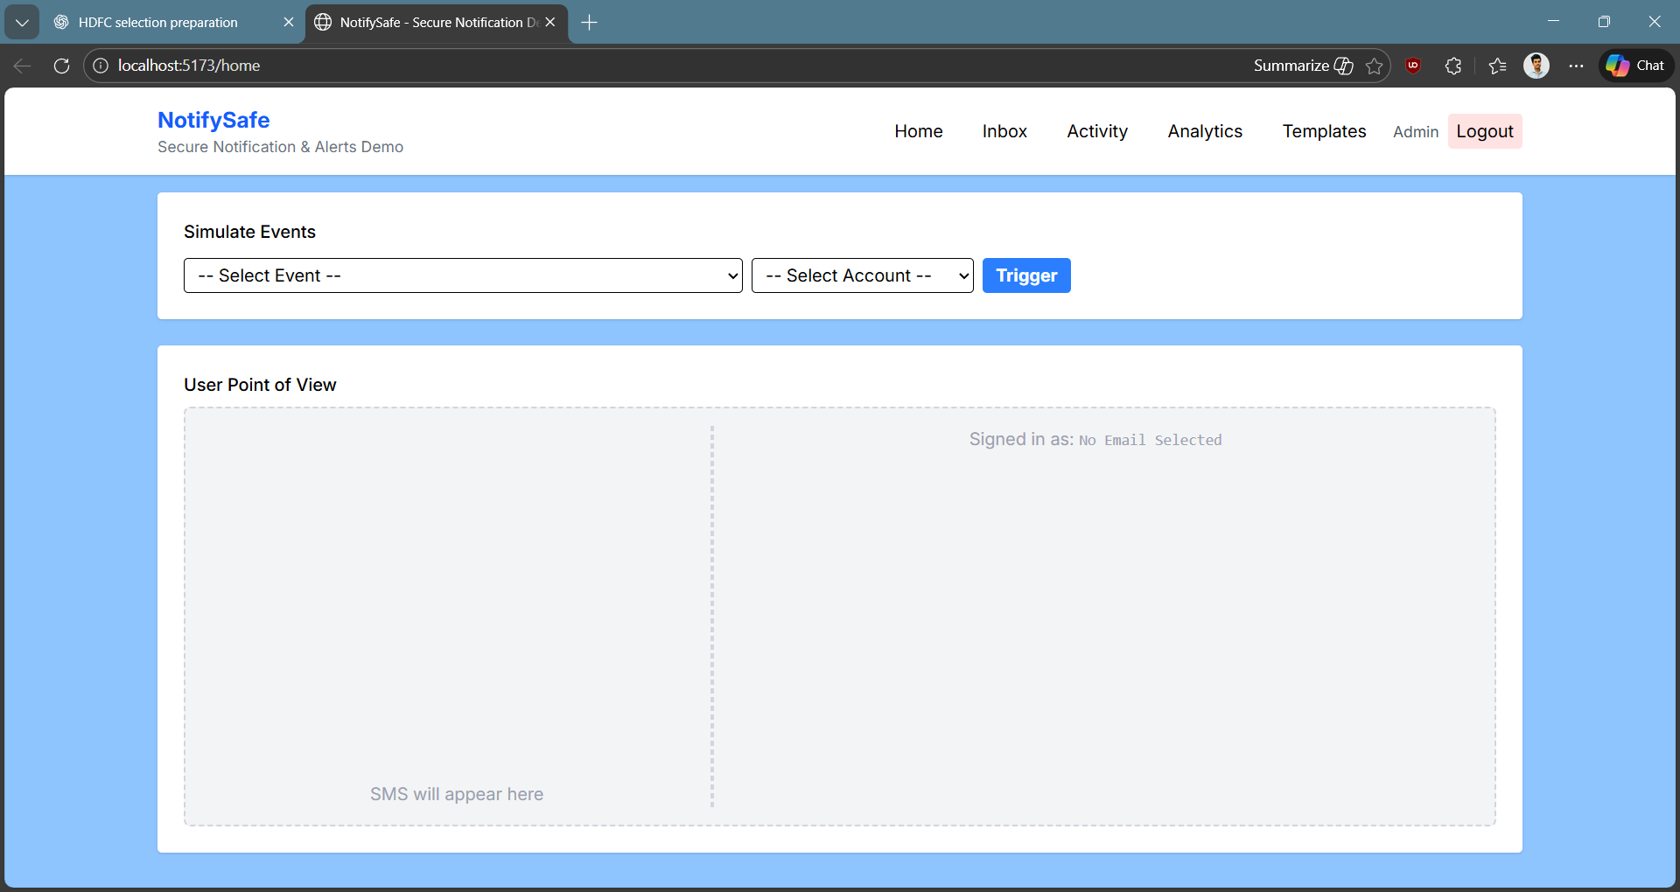
Homepage

Slide 19
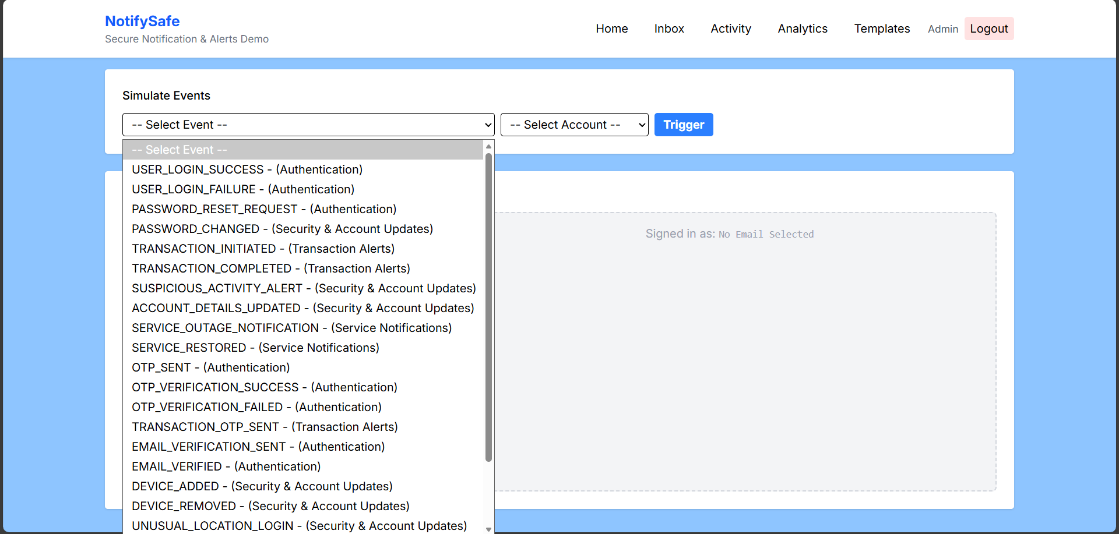
Events

Slide 20
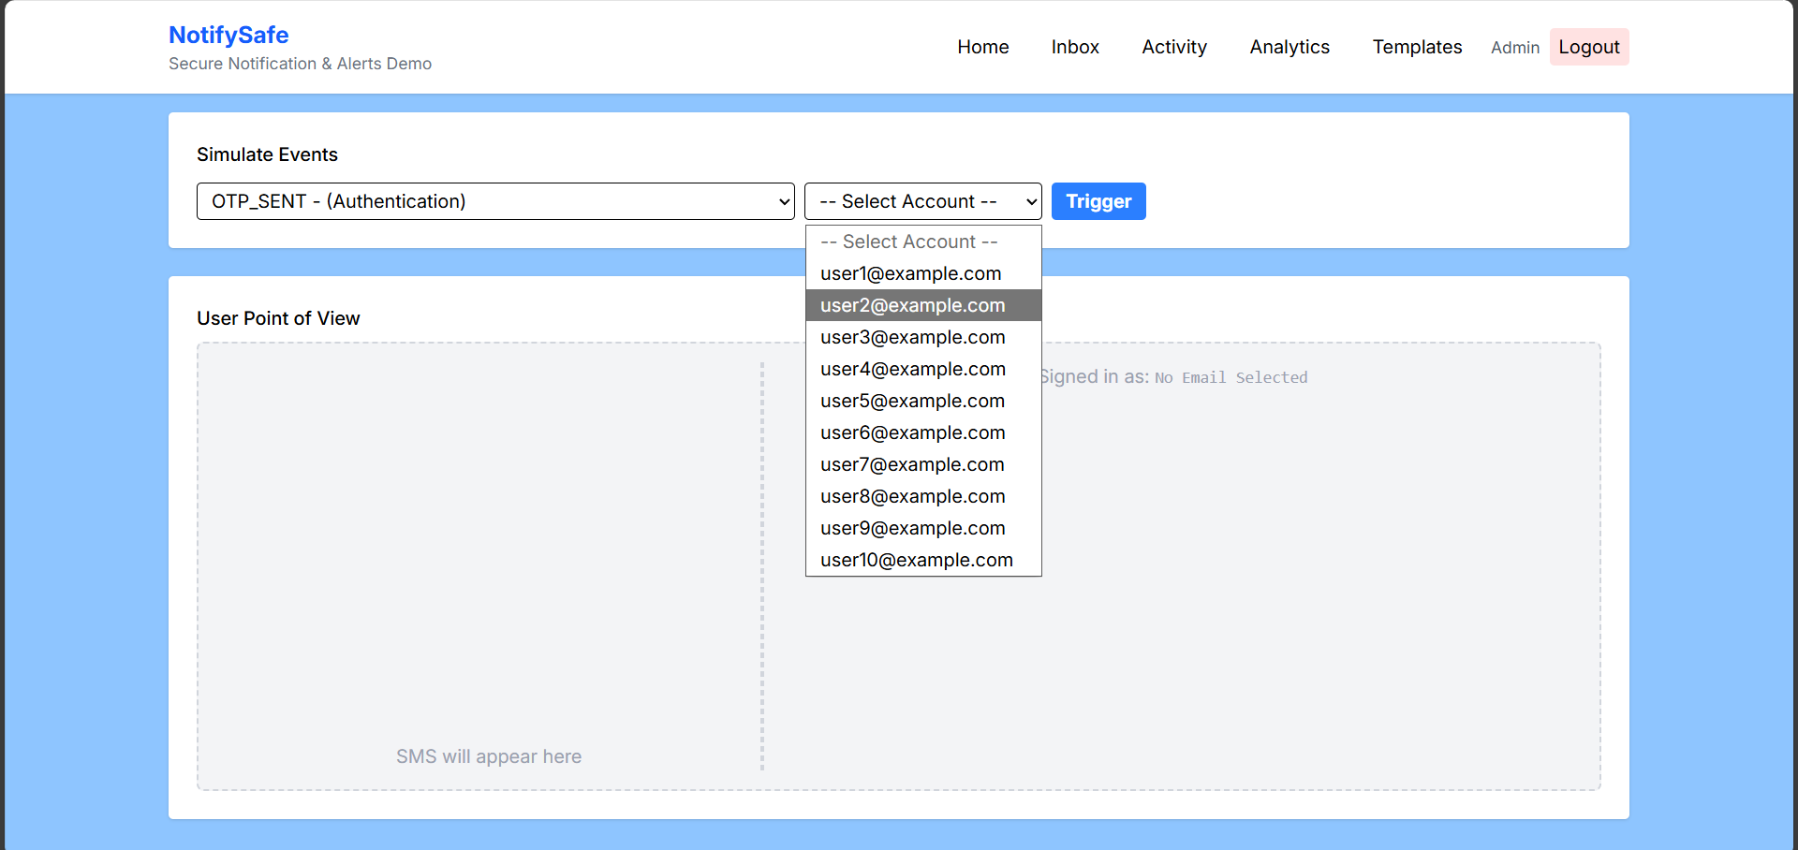
User Impersonation

Slide 21
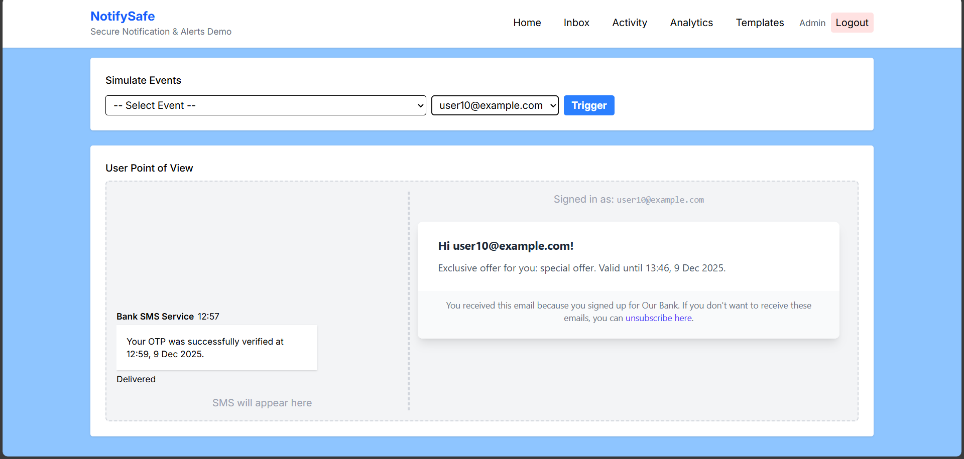
User Point of View

Slide 22
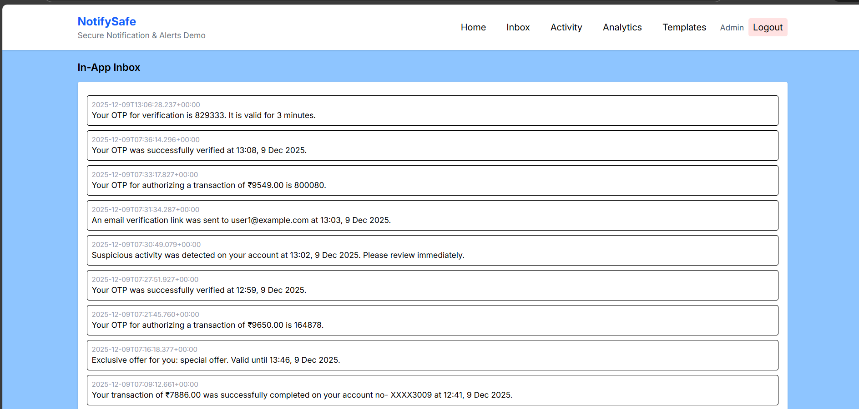
Inbox

Slide 23
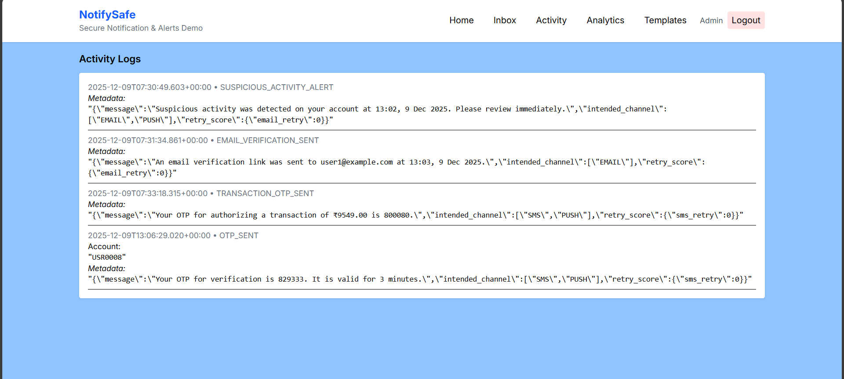
Activity

Slide 24
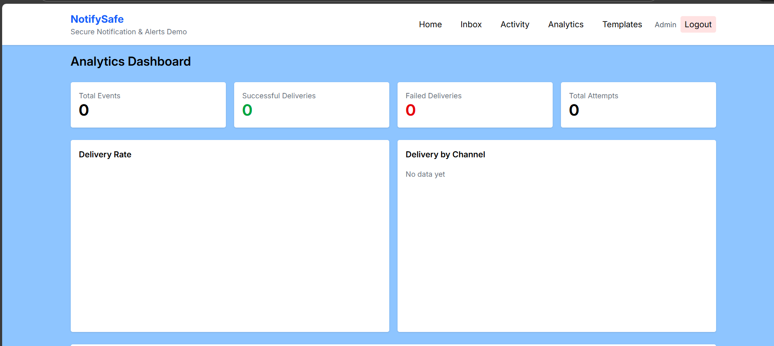
Analytics
Note: Will be implemented in near future.

Slide 25
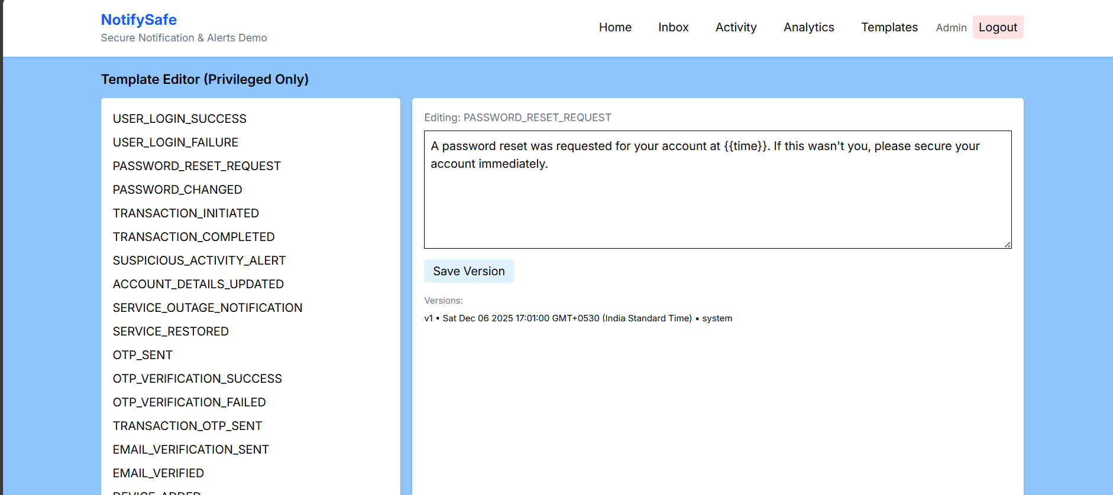
Templates

Slide 26
Impact
My solution:
✅Improves customer communication reliability.
✅Standardizes message formatting.
✅Enables quick debugging with activity logs
✅ Helps to create audit trails
✅ Security Considerations
✅ Controlled Access(Admin Previleges)
✅ Template safety (prevents tempering)
✅ Event validation
✅ Inbox shields sensitive messages
✅ Audit logs for accountability

Slide 27
Limitations & Future Enhancements
Current Limitations:
❌No real SMS/Email gateway
❌ Limited analytics (work in progress)
Future Enhancements:
Real delivery using Twilio / SendGrid
Push notifications
Dashboard charts + insights
ML-based fraud detection suggestions

Slide 28
Conclusion
NotifySafe effectively solves the problem of delivering secure, reliable, and real-time notifications for banking environments.
It provides a complete end-to-end demonstration of how bank notification systems work internally.

Slide 29
Thank You

